Slide 1


Slide 2
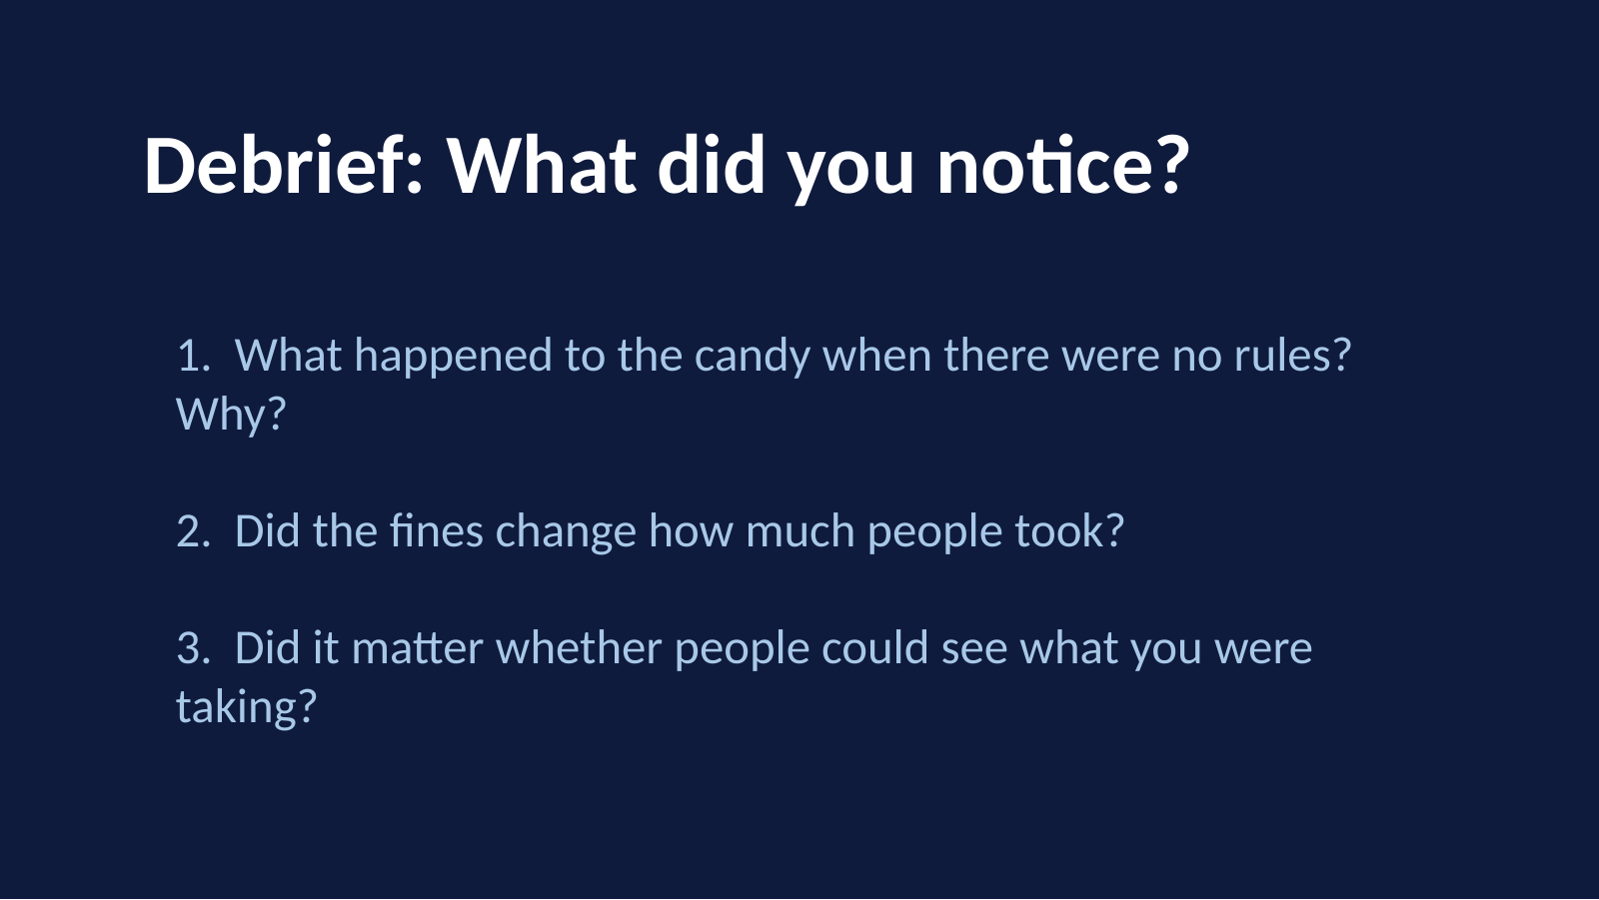

Slide 3
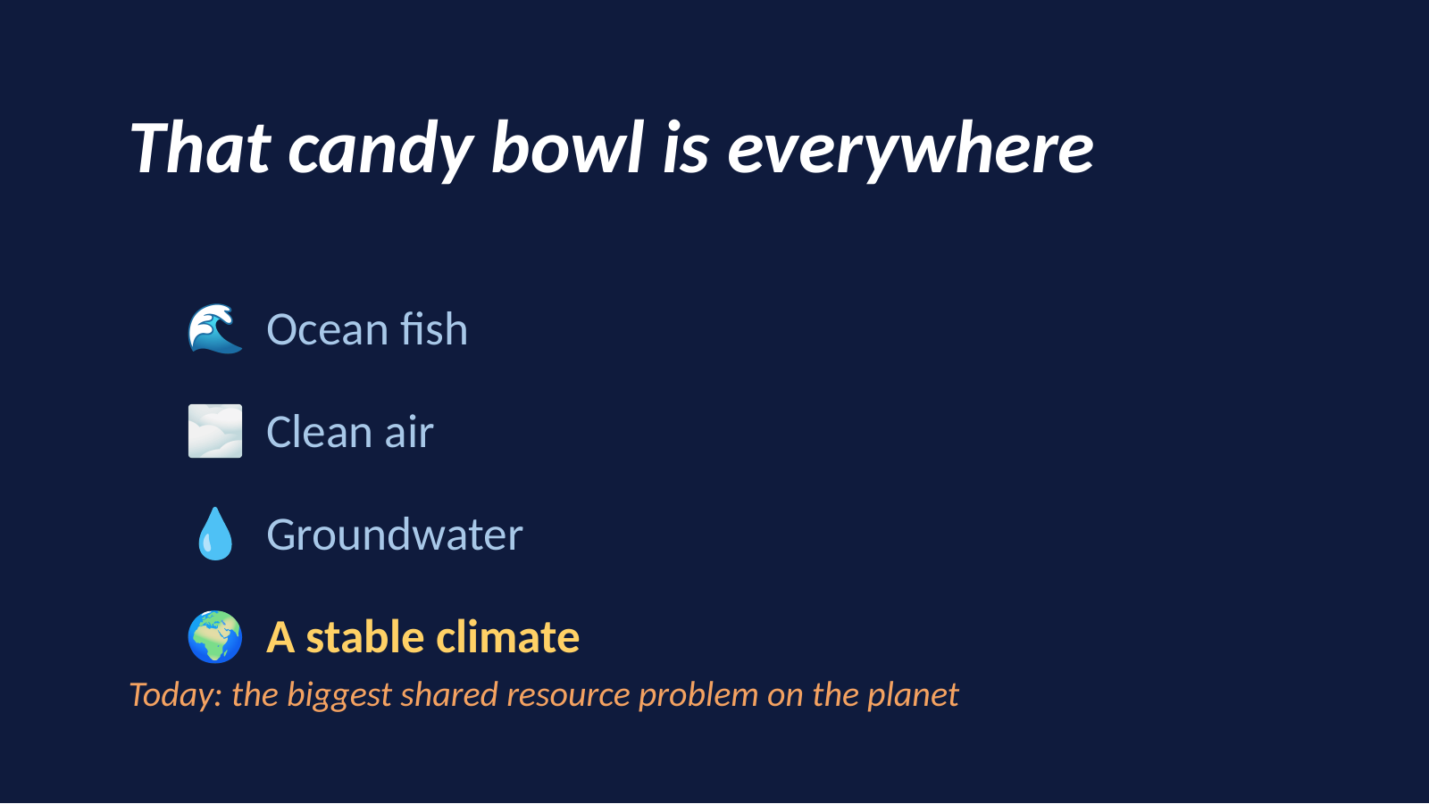

Slide 4
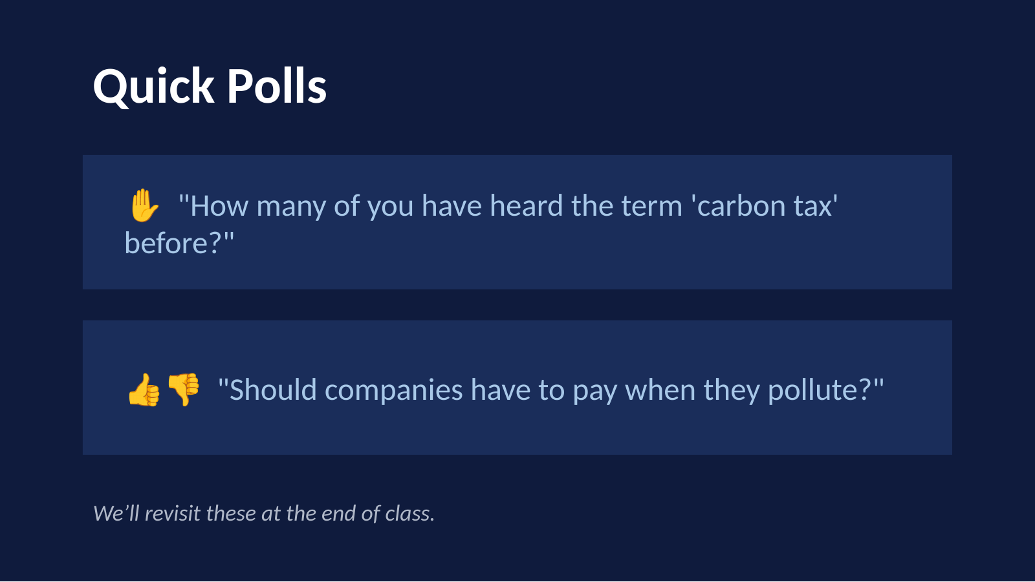

Slide 5
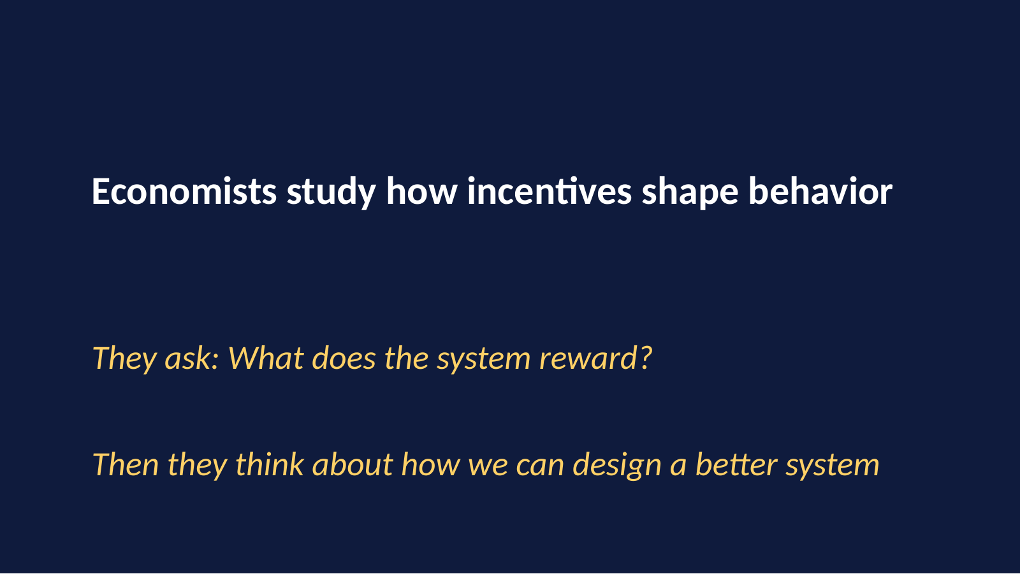

Slide 6
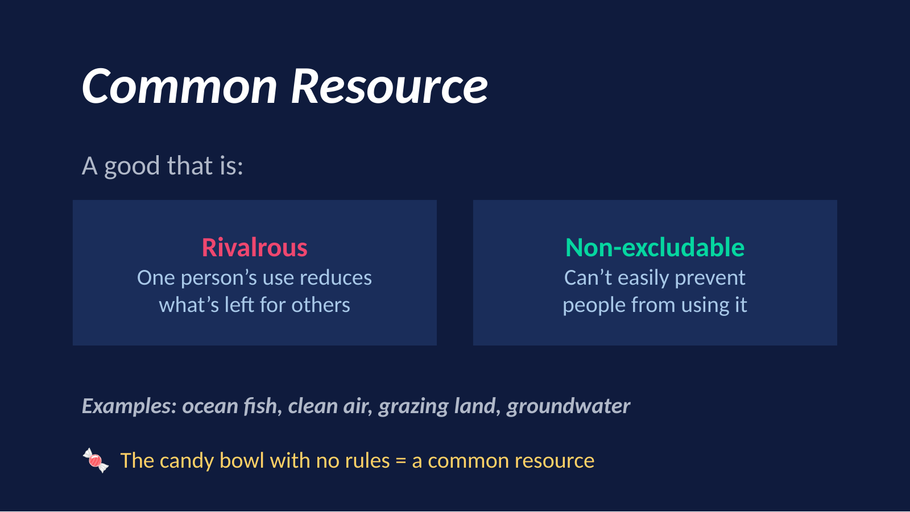

Slide 7
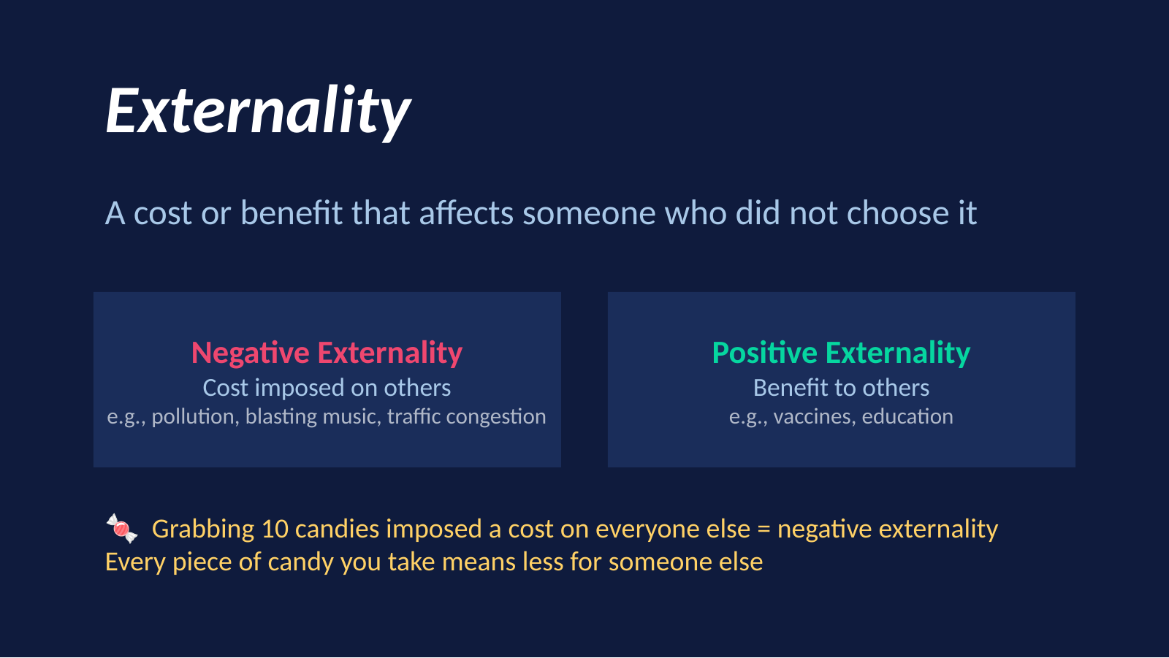

Slide 8
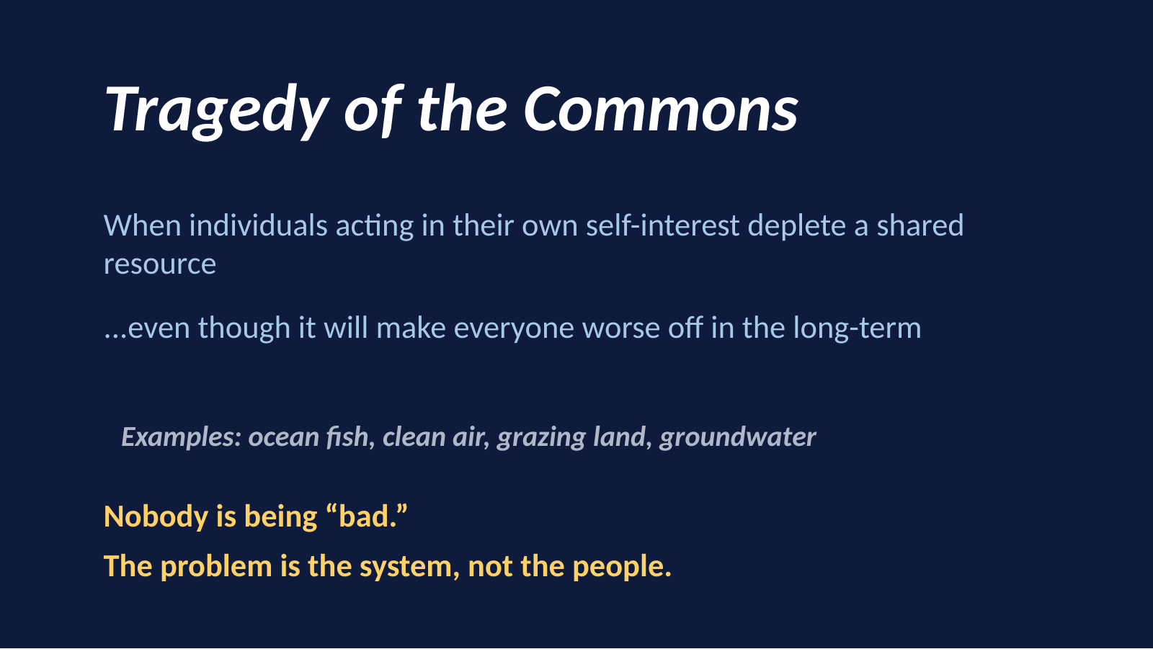

Slide 9


Slide 10
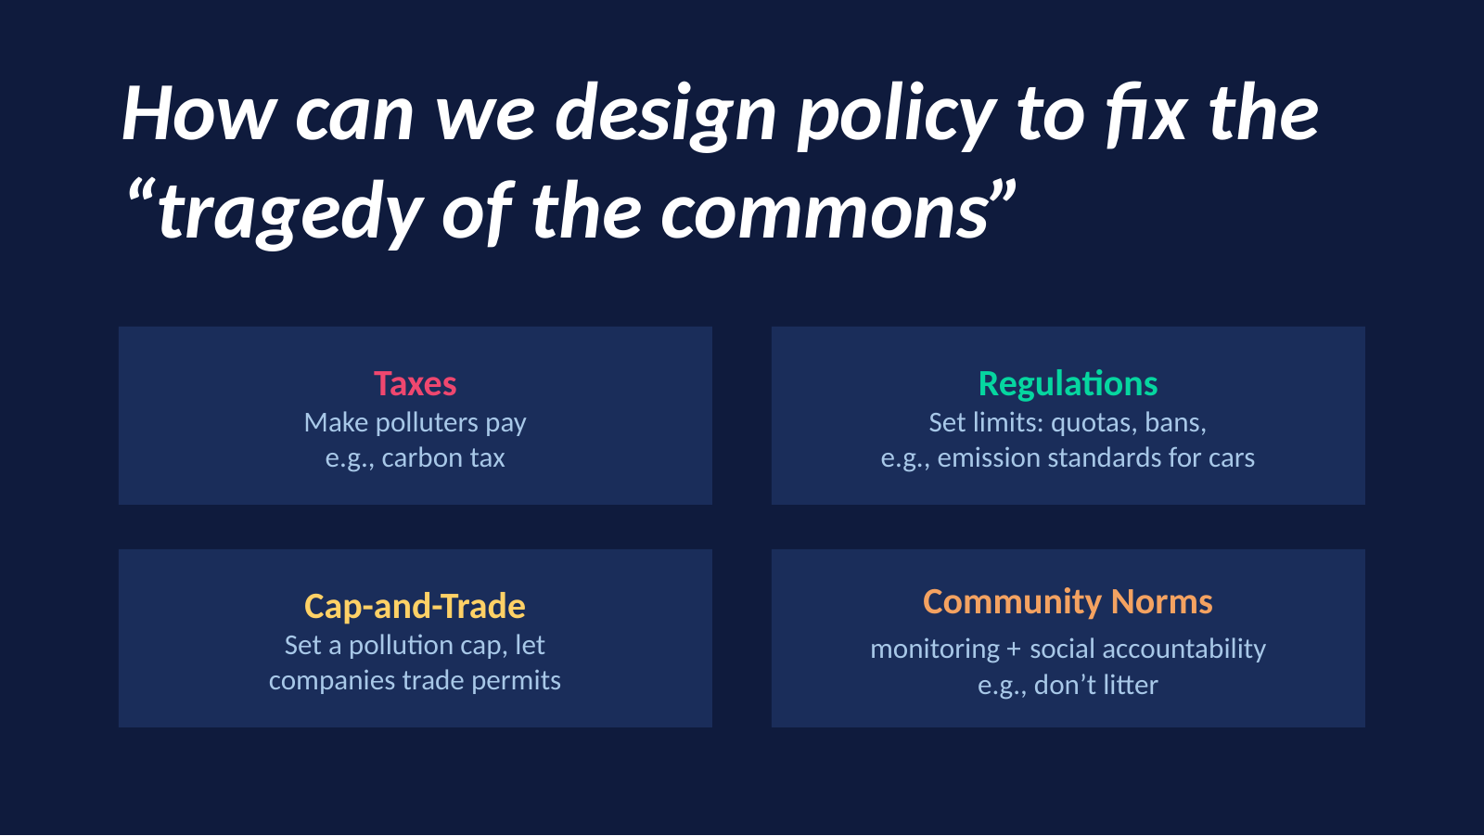

Slide 11
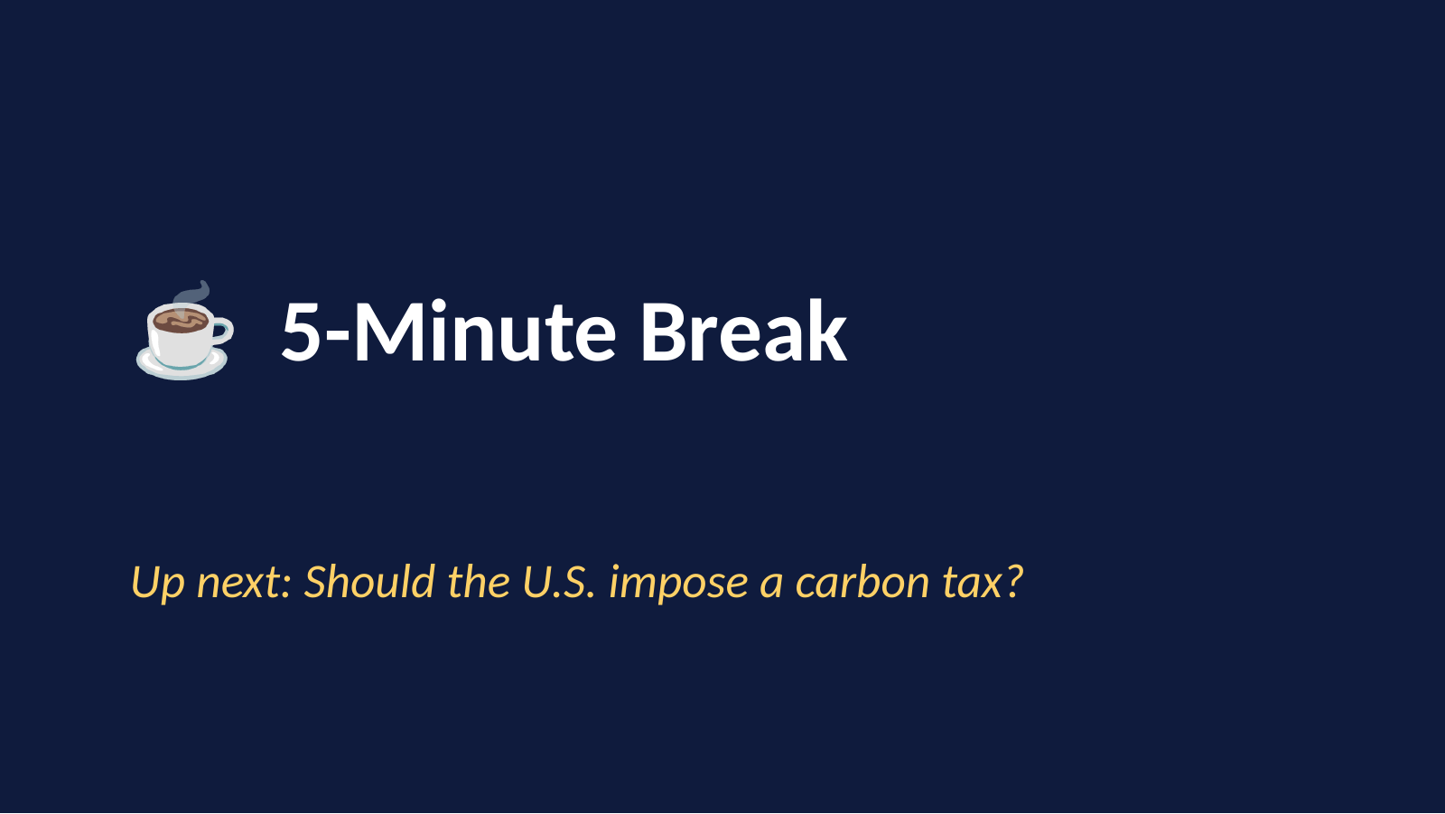

Slide 12
Policy discussion
Should the U.S. put
a price on carbon?
Notes:
Instead of having a chaotic ‘for or against’ debate, we are going to act like policy analysts. We will answer four questions in order. If we skip steps, the conversation gets messy.

Slide 13
A four-question decision framework
Answer in order; do not jump straight to yes / no.
1
Problem
2
Incentives
3
Trade-offs
4
Revenue
What market failure or shared-resource problem are we trying to fix?
If carbon becomes more expensive, what choices change?
Who gains, who pays, and what concerns remain?
If government collects money, what should it do with it?
Economics lens: compare how a rule changes incentives and distribution — not just whether it sounds fair.

Slide 14
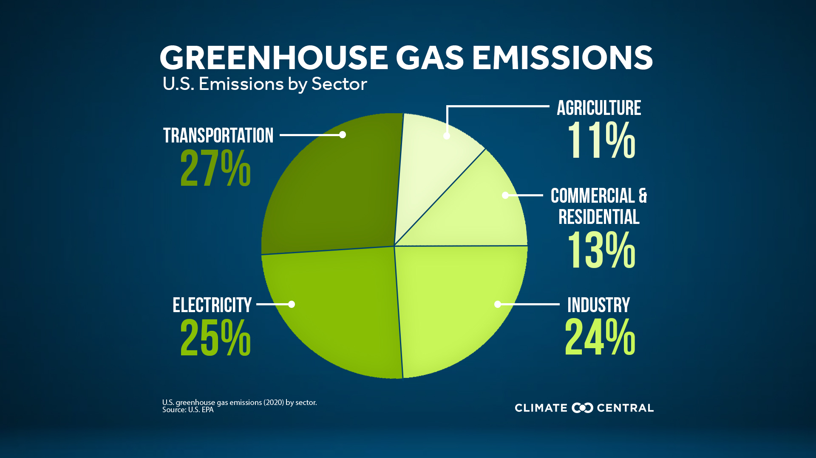
1. What problem is the policy trying to fix?
• Carbon emissions create a negative externality.
• The price of many carbon-intensive choices misses part of the climate cost.
• Result: society gets more emissions than is socially efficient.
The missing cost is the policy target.
Carbon comes from many parts of the economy, so the question is not “one bad industry” — it is how to change incentives across sectors.
Notes:
Visual reminder: emissions are spread across transport, electricity, industry, buildings, and agriculture.

Slide 15
2. How does a carbon tax change incentives?
Cleaner options look cheaper
Emit carbon
→
Pay more per ton
→
Carbon-intensive fuels or activities
The private cost gets closer to the social cost
Fuel switching, and innovation become more attractive
Households
Firms
Innovators
May conserve energy, change transport choices, or switch technologies over time.
May improve efficiency, change fuel mix, or invest in cleaner production.
Gain a bigger market for low-carbon products and services.
Key idea: the tax does not order one specific action — it changes the relative prices that guide many decisions.

Slide 16
Carbon pricing around the world
28%
EU ETS
Cap-and-trade system; over €175B raised since 2013.
of global GHG emissions are covered by a direct carbon price
Singapore
Carbon tax at S$25/t in 2024–25; higher path already announced.
Sweden
Long-running carbon tax; about €138/t for natural gas and coal in 2026.
>50
countries
South Africa
Carbon tax rose to ZAR 236/t in 2025, with phase-ins for competitiveness.
now use a carbon tax or an emissions trading system
Same idea, different designs: countries choose different prices, coverage rules, and uses of the revenue.
Notes:
[Sources] - World Bank, State and Trends of Carbon Pricing 2025: https://www.worldbank.org/en/publication/state-and-trends-of-carbon-pricing - OECD press release on Effective Carbon Rates 2025: https://www.oecd.org/en/about/news/press-releases/2025/11/carbon-pricing-mechanisms-are-evolving-to-meet-a-broader-range-of-policy-objectives.html - European Commission, About the EU ETS: https://climate.ec.europa.eu/eu-action/carbon-markets/about-eu-ets_en - Singapore NEA carbon-tax page: https://www.nea.gov.sg/our-services/climate-change-energy-efficiency/climate-change/carbon-tax - Government Offices of Sweden, Sweden’s carbon tax: https://www.government.se/government-policy/taxes-and-tariffs/swedens-carbon-tax/ - OECD Effective Carbon Rates 2025 report for South Africa changes in 2025.

Slide 17
3. What trade-offs should we examine?
Potential benefits
Real concerns
• Lower emissions over time
• Stronger incentive for efficiency and clean innovation
• New public revenue that can fund rebates or investment
• Higher energy and transport prices in the short run
• Low-income households may be hit hardest without support
• Some firms worry about competitiveness if rivals face weaker rules
Good policy debate = compare benefits, costs, and who bears them.
Notes:
[Sources] - IMF climate-mitigation overview on carbon taxes, household support, and growth-friendly design: https://www.imf.org/en/topics/climate-change/climate-mitigation - European Commission, About the EU ETS (revenue use and cost-effective incentive): https://climate.ec.europa.eu/eu-action/carbon-markets/about-eu-ets_en

Slide 18
4. What should government do with the revenue?
Return cash to households
Helps with fairness and visible affordability.
Invest in clean energy / transit
Builds alternatives that make cutting emissions easier.
Cut another tax or mix approaches
Some governments blend rebates, investment, and tax reform.
Notes:
[Sources] - IMF climate-mitigation overview on using carbon-tax revenue to support low-income households and green transition: https://www.imf.org/en/topics/climate-change/climate-mitigation - Singapore NEA carbon-tax page (revenue used to support transition and cushion impacts): https://www.nea.gov.sg/our-services/climate-change-energy-efficiency/climate-change/carbon-tax

Slide 19
Stakeholder hearing: make one recommendation
Groups:
households
firms
government
Structured worksheet
1. The main problem we are trying to fix is …
1
State the problem in one sentence.
2
Explain what choices the tax would change.
2. The biggest trade-off we still worry about is …
3
Compare short-run costs and long-run benefits.
3. Our recommended design is … because …
4
Choose a revenue design before your vote.
Vote options:
No tax
Tax + rebate
Tax + green investment
Hybrid

Slide 20


